Slide 1
BANKING AND FINANCING FOR PUBLIC CHARTER SCHOOLS

Slide 2



OCEAN CHARTER SCHOOL
Banc of California:
Who We Are
Our Personalized Customer Approach
Financial Stability & Predictability for Charter Public Schools
Appendix A:
Testimonials
Appendix B:
BOC Foundation

Slide 3
WHO WE ARE

Slide 4
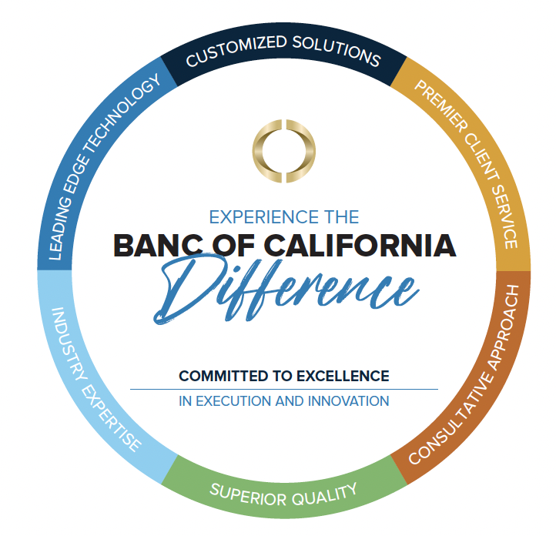
BANC OF CALIFORNIA: WHO WE ARE
We are California’s premier, relationship-focused, full-service business bank.
$10B in assets and headquartered in the heart of Orange County
Big-bank expertise and capabilities, with the tailored solutions and personal service of a community bank
CA Market Experts: We have developed a customized suite of products designed to meet the diverse needs of Californians and deliver the exact financing they need
Over 3,650 employee volunteer and service hours and contributed $145MM to support community organizations
Charter School Market Experts: We have developed a customized suite of products designed to meet the diverse needs of charter schools

Slide 5
TOGETHER WE WIN®
WE ARE CALIFORNIA’S BUSINESS BANK
We are strategically positioned to support industries integral to California’s economy.
Local Decision Makers and industry expertise
28 Branches
in Southern California
Our Products Are Tailored for California’s Diverse Businesses and Communities
Banc of California provides entrepreneurs and growing businesses with customized financial solutions and sound advice. We have developed a comprehensive suite of products and services designed to help businesses maximize their operating efficiency.
+7 BILLION
HEALTHCARE
ENTERTAINMENT
EDUCATION
2022 Lending* to industries, including:
MANUFACTURING
REAL ESTATE
NONPROFIT
We have the financial strength, industry knowledge and depth of resources to help our clients achieve their financial goals.
*Consolidated year-to-date loans as of 12/31/2022.

Slide 6

WE’RE INVESTING IN COMMUNITIES TO BUILD
A STRONGER CALIFORNIA
We are committed to serving the communities of California and joining the effort to deliver resources our communities need.
By developing meaningful partnerships with a broad array of organizations, we serve our diverse population and make a positive impact through at-risk youth programs, affordable housing, veterans services, community revitalization, financial education and workforce development.
$210M+
Community Development Investments
$360M+
Small Business CRA Loans in California
6,400+ Service Hours
Employees and Volunteers
$1B+
Community Development Loans

Slide 7

WE ARE FINANCIALLY STRONG
Banc of California Is Financially
Strong, with Significant Capital
Banc of California, Inc. (NYSE: BANC) is a bank holding company with $9.4 billion in assets as of June 30, 2023 and one wholly-owned banking subsidiary, Banc of California, N.A. (the Bank). The Bank has 34 offices including 28 full-service branch locations throughout Southern California. Banc of California provides customized and innovative banking and lending solutions, as well as full stack payment processing solutions through its subsidiary Deepstack Technologies.
Banc of California’s total revenues on a consolidated basis for the quarter ended June 30, 2023 were $75.7 million. Banc of California, Inc. is considered "well capitalized" with $957.1 million in shareholders' equity and a total risk-based capital ratio of 14.26% as of June 30, 2023, achieving the highest capital category for banks.
Financial Data (as of and for the quarter ended 6/30/2023)
($ in millions)
Total Revenue
$75.7
Total Gross Loans
$7,156.2
Total Assets
$9,370.3
Total Deposits
$6,871.1
Total Stakeholders’ Equity
$957.1
Bank Capital Rating
Well Capitalized
Market Cap²
$839.7
²As of 4/19/2023

Slide 8
SPECIALTY BANKING
We offer a portfolio of overlapping banking and lending products for that now includes public charter schools as a strategic priority
Single Point of Contact
  Your experienced and dedicated Relationship Manager will take the time to meet with you or your team to understand you, your office and your goals. They are available 24/7 to conveniently handle all your banking needs.
Specialty Banking Services
  Dedicated Relationship Manager
  Highest Level of Personal Service
  Exclusive Loan and Financing Products
  Preferred Business Banking Services
  Account Access While Traveling
Specialty Banking Expertise Includes:
Charter Schools
Nonprofit
Education
Entertainment
Bankruptcy Banking
Healthcare Banking
Legal and Fiduciary Banking
Our Specialty Banking services are tailored to you. We hold ourselves to an exceptional level of client service and personal attention to empower you to meet all your banking needs.
See Banker for full product listing, program details and requirements.

Slide 9

OUR PERSONALIZED CUSTOMER APPROACH

Slide 10
UNIQUELY POSITIONED TO SERVE
CHARTER SCHOOLS
OUR STRENGTHS
Tailored Relationship-Based Approach
Charter School Expertise
Customized Financial Solutions
Comprehensive Suite of Products and Services
Experience
BOC team has decades of charter school experience and thoroughly understands the unique challenges that face charter schools
Recent Solutions under BOC Banner
Developed and deployed customized banking and financing solutions for 42 schools that serve ~17K students
$150+ million in banking relationships with school based clients
Service
BOC products developed specifically for charter schools
In-depth Treasury & Finance solutions

Slide 11
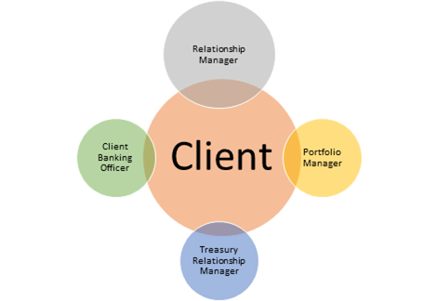
TEAM APPROACH
  A dedicated Relationship Manager and Banker is your direct point of contact. Our team understands your business and can anticipate your needs with products that grow with you.

Slide 12
MARKET PROVEN CHARTER SCHOOL FINANCING
Facilities & Line of Credit
$21,500,000
Oakland, CA
Line of Credit
$2,500,000
El Segundo, CA
Line of Credit
$200,000
Long Beach, CA
Line of Credit
$1,000,000
Highland Park, CA
Line of Credit
$850,000
Riverside, CA
Line of Credit
$4,500,000
Los Angeles, CA

Slide 13

FINANCIAL STABILITY & PREDICTABILITY
FOR CHARTER PUBLIC SCHOOLS

Slide 14
Our services are Tailor made for charters
Treasury & Banking Services – customized to fit your needs and save you time
  You have a dedicated team that knows your school
  Select the services you need:
    Business online banking: proven model for charters
    Optimize cash management
    Manage all deposits remotely – make your deposits when you need to, regardless of amount
    Fraud prevention services: we save you time by watching out for your school and calling you if there is a question
    Do your business on YOUR system
Direct Lending through a BOC program developed for Charter Schools
  Lines of Credit: address mismatch in timing between expenses and revenue
  Real Estate/Facilities: upgrade or purchase your facilities
  Term Loans: convert cash needs into known and consistent payments
Loans and lines of credit are subject to underwriting guidelines and other terms and conditions. Not an offer of credit.

Slide 15
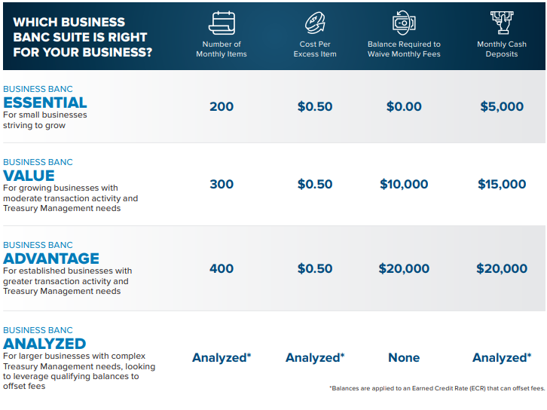
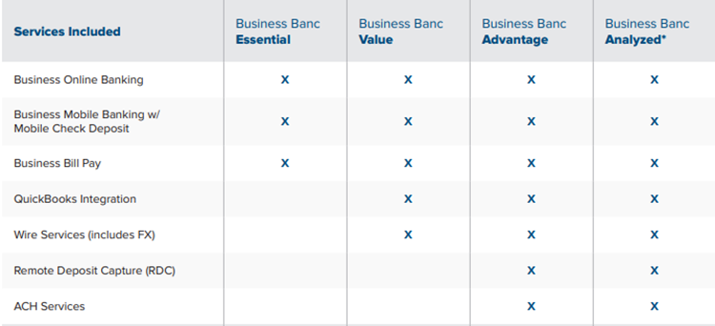
DEPOSIT ACCOUNT OPTIONS
1. For accounts with a lower level of monthly Activity, our Banking Bundle accounts include a mix of products based on account activity, with lower monthly deposit requirements. Excess funds over the minimum balance requirement can sweep into an interest bearing account with ICS

Slide 16
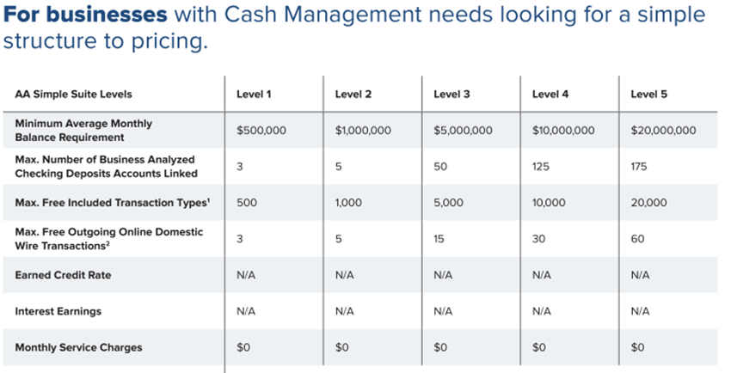
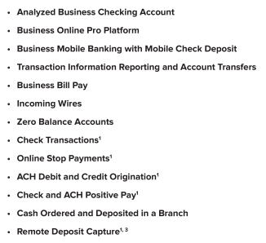
ACCOUNT ANALYSIS SUITE CHECKING
2. For accounts with a higher level of activity Account Analysis Simple Suites provide a suite of services
Available based on a minimum level of deposit balances. Excess funds over the Suite minimum balance requirement can sweep into an interest bearing account with ICS

Slide 17
Charter school line of credit
Typical Terms
  Amount: based upon school revenue and credit quality. Designed to cover 100% of deferrals.
  Pricing: variable rate based on Wall Street Journal Prime
  Term: Up to 2 Years
How it Works
  No minimum draw required
  No zero-balance requirement
  Funds available same-day/next day
  Draw and Pay down to meet your cash needs - use exactly what you need when you need it, thus minimizing cost
  Payments: monthly interest only auto-collected; principal due at end of term
Loans and lines of credit are subject to underwriting guidelines and other terms and conditions. Not an offer of credit.

Slide 18
Additional financing options
Deferrals: the line of credit is designed to cover deferrals
Real Estate/Facilities
  Loan based on appraisal
  Line of Credit can support as needed
Term Loan
  Fixed Rate over a specified number of years
  Monthly payment of principal and interest
Loans and lines of credit are subject to underwriting guidelines and other terms and conditions. Not an offer of credit.

Slide 19
APPENDIX A:
CHARTER TESTIMONIALS

Slide 20
OUR CLIENTS AND PARTNERS
“Instead of dwelling on the ‘learning loss’ during the COVID pandemic, we need to recognize the ‘learning gain’. At Academia Avance, our students, together with our teachers and parents and staff, learned to adapt. We are happy to have a bank with innovative finance products and services supporting our continuous adaptation to increase learning gain at Avance.”
Ricardo Mireles
Executive Director
Academia Avance
“Banc of California is a huge partner in education and specifically Charter Schools. Our financial position has been improved tremendously by Banc of California's Line of Credit. Now, we can ‘Be the Solution’ for our Achievers at Garvey/Allen STEAM Academy without worrying about our finances. Thank you, Banc of California, for your partnership.”
Tiffany Gilmore
CEO/Superintendent & Founder
Allen STEAM Academy
"Banc of California was very supportive and forward-thinking in their approach. We relied on their expertise and Banc of California really understood and was able to meet our needs. We now have a beautiful school building for our high school students, and this would have not been possible without Banc of California's support."
Sundar Chari
Chief Business Officer
Education for Change
“Throughout the entire process of applying for our Line of Credit with Banc of California, the Banc of California team was responsive, supportive, informative and encouraging. Their customer service was top notch which created for a seamless experience along the way.”
Charla N.
Austin-Harris
Founder & Executive Director
Learning by Design Charter School
“This is the first true partnership with a bank that I have had in my 30 years as an educator and school leader. John really understands the sector, which makes our interactions efficient and effective. The staff at Banc of California are responsive and helpful. Working with Banc of California is truly the best of both worlds: customized support you expect from a boutique organization coupled with the experience and longevity of a large bank.”
Anita Ravi
Executive Director, Principal
We the People High School

Slide 21

APPENDIX B:
BOC Foundation

Slide 22





BANC FOUNDATION: TOGETHER WE CAN
At its best, California is about people working together to achieve things greater than themselves. Businesses that create shared prosperity and opportunity. Communities that foster connection and universal respect. Organizations that improve the lives of people in need.
As California’s Business Bank, we partner with many service organizations, businesses, entrepreneurs and individuals to help them achieve those goals, through the BANC Foundation. We donate to them. We lend to them. And our employees enthusiastically volunteer in their initiatives.
We concentrate our philanthropy on four areas where we can make it especially valuable:
FOUR PILLARS OF PHILANTHROPY
Financial Literacy
Community Services & Volunteerism
Affordable Housing
Economic Growth

